Slide 1


Influencing Factors behind Video Game Sales
Data Science Project — VGChartz 2024 Dataset Analysis
Group Number: Group 23
Group Member: Fengyuan Zuo 320230992841
Fanzhou Bu 320230941681
Rui Zhong 320230942781
Tianxiao Yang 320230942631
Zijie Gong 320230941871
Report date: 2026/7/1

Slide 2



01.
Problem Statement & Motivation
CONTENTS
02.
Data & Preprocessing
03.
EDA & Key Findings
04.
Model & Evaluation
05.
Conclusion

Slide 3



01
Problem Statement &
Motivation

Slide 4

Project Overview
Tech advancements and more users have boosted the global gaming industry. Sales are key for developers, publishers and investors’ decisions. Yet, overlapping factors (platforms, genres, regions, publishers) make traditional experience-based judgments inadequate.
Market Positioning for Developers
Investment Strategy for Publishers
Main Objective
This project uses VGChartz’s 2024 game sales dataset to quantify how platform, genre, publisher brand, and critic scores influence global sales, providing data-driven insights for market strategy in the gaming industry.
Value Assessment for Investors

Slide 5
Three Questions Driving Our Analysis
Game Genre-Regional Sales Impact
Platform-Game Genre Synergy
Publisher Brand Impact on Sales
Do specific platform-genre combinations deliver sales premiums?
e.g., PS4 x Sports vs. Xbox Sports Informs platform strategy and release planning
Do genre preferences vary across North America, Japan, and Europe?
e.g., RPGs in Japan vs. Shooters in NA Informs regional marketing allocation
Does publisher/developer brand impact sales through scale or prestige?
e.g., EA volume vs. Nintendo premium Informs partnership decisions
Context: The global video game market exceeds $200B. Understanding what drives success is critical for developers, publishers, and investors.

Slide 6
02
Data & Preprocessing

Slide 7
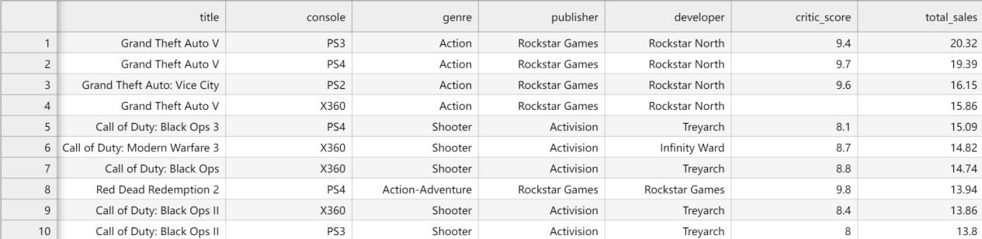
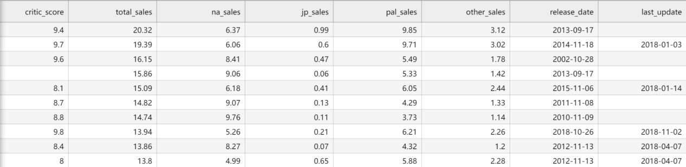
Dataset Structure Introduction
64,016
Platform & Genre
Developer & Publisher
Hardware ecosystem and content classification
Content creation and brand power
Game record
Game ratings (critic_score)
Regional Sales Volume
Covering 14 core variables
Evaluation and Reputation
Market performance and regional differences

Slide 8
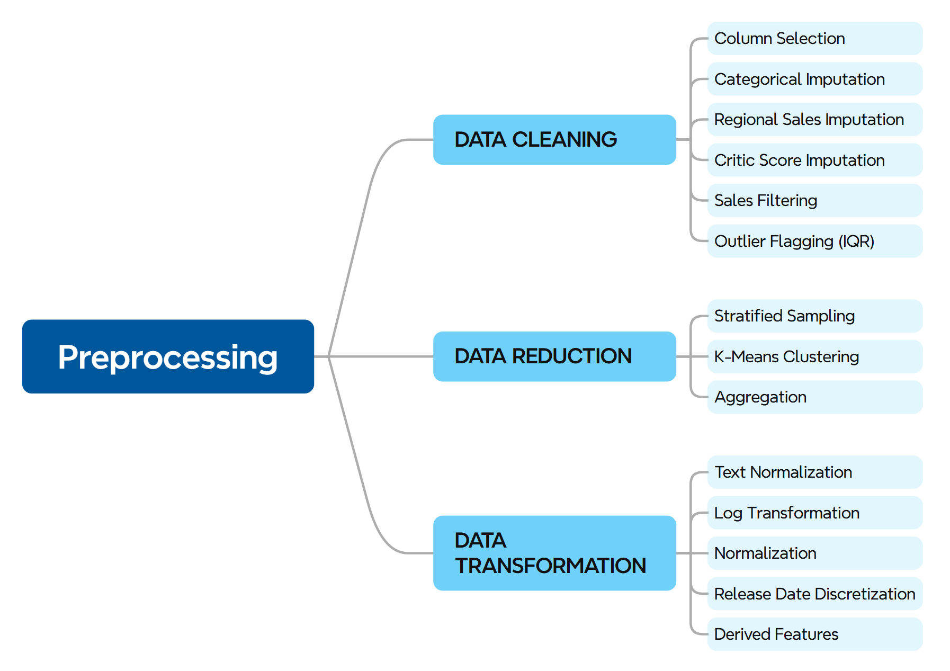
Dataset Preprocessing
Raw Dataset
Data Cleaning
Data Reduction
Data
Transformation
Dataset Ready
Dataset Overview
Attribute | Value
Raw data source | vgchartz-2024.csv
Initial shape | 64,016 rows × 14 columns
After cleaning (pre-reduction) | 17,570 rows × 16 columns
Final shape | 8,786 rows × 33 columns
Overall retention rate | 13.7% (8,786 / 64,016)

Slide 9
03
EDA & Key Findings

Slide 10
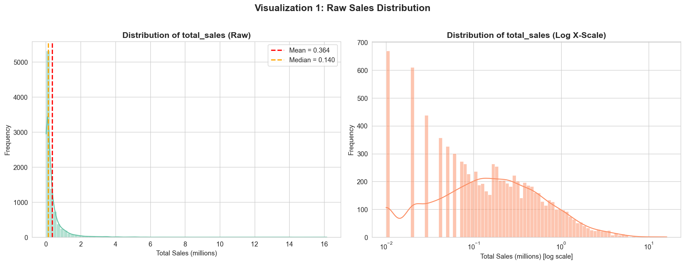
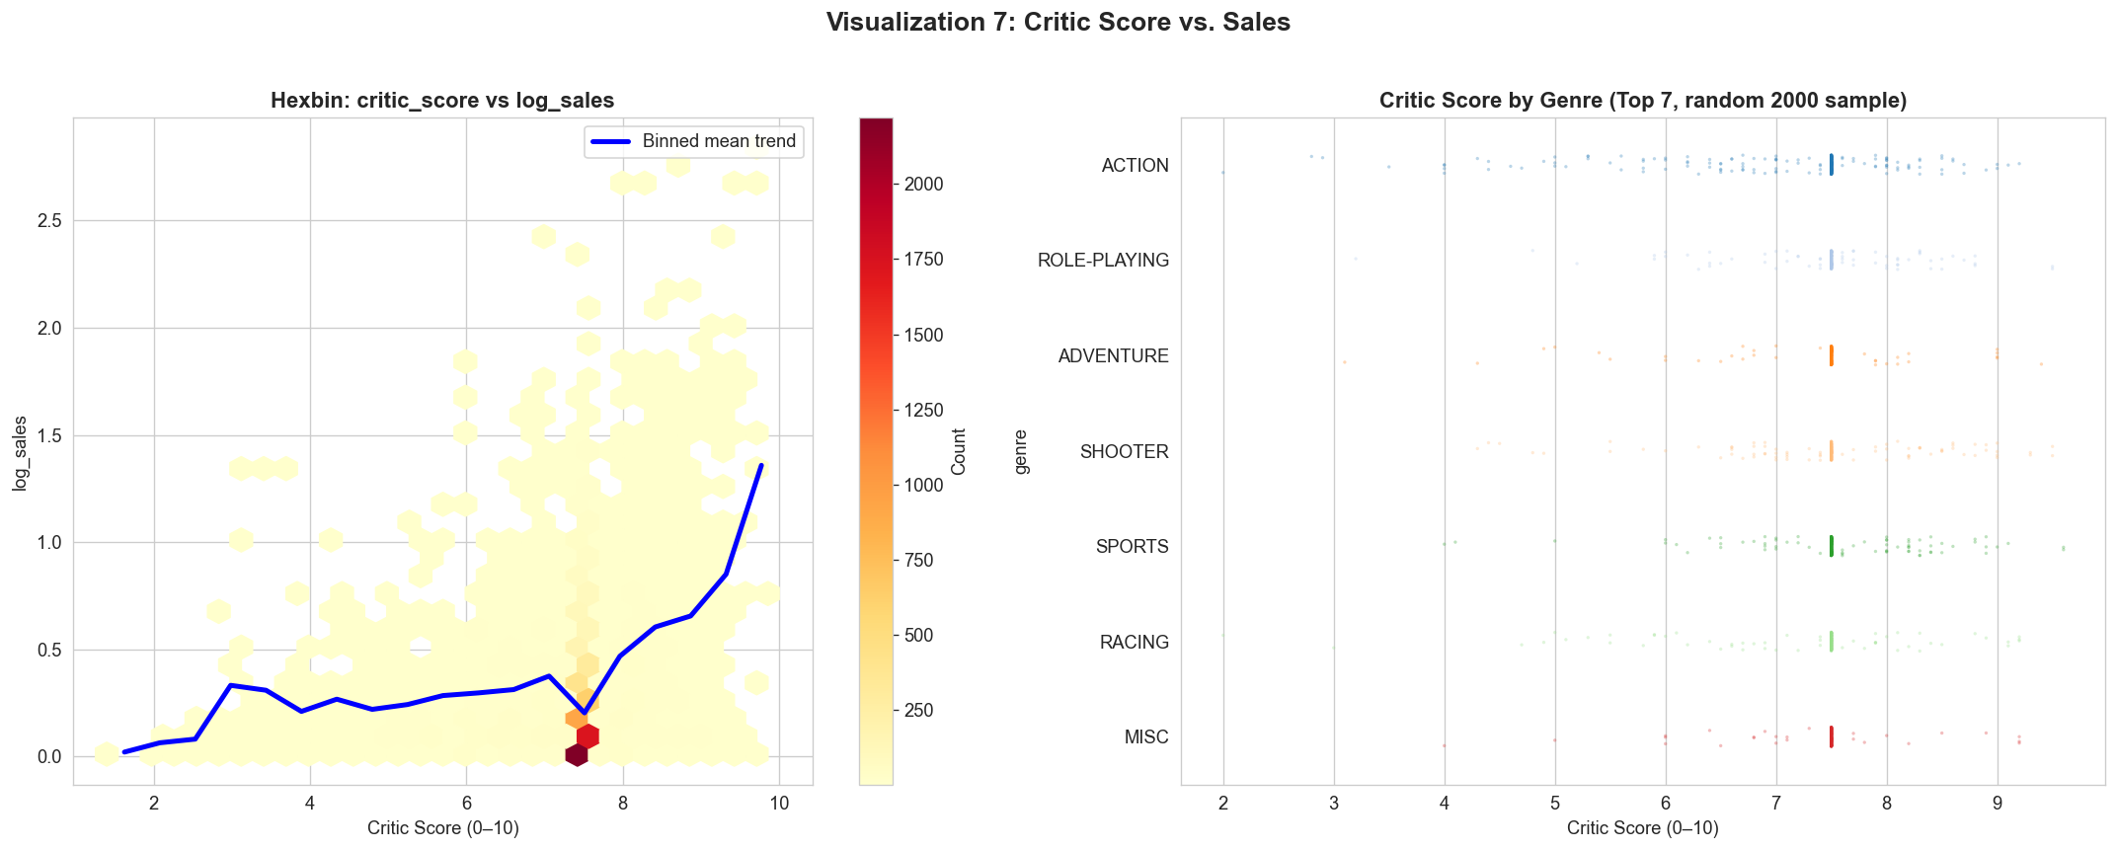
Key Findings and Modeling Assumptions
●Sales are extremely right‑skewed (skewness 8.04); log‑transformation is required .
●Critic Score correlates negligibly with sales. Even perfect scores show enormous sales spread.
●Platform and genre alone are weak discriminators; the real signal lies in their interaction effects.
Critic Score should not be a primary feature. Modelling should instead focus on combinatorial and regional variables.

Slide 11
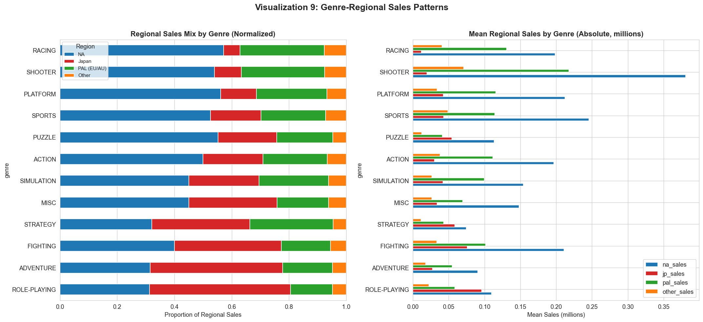
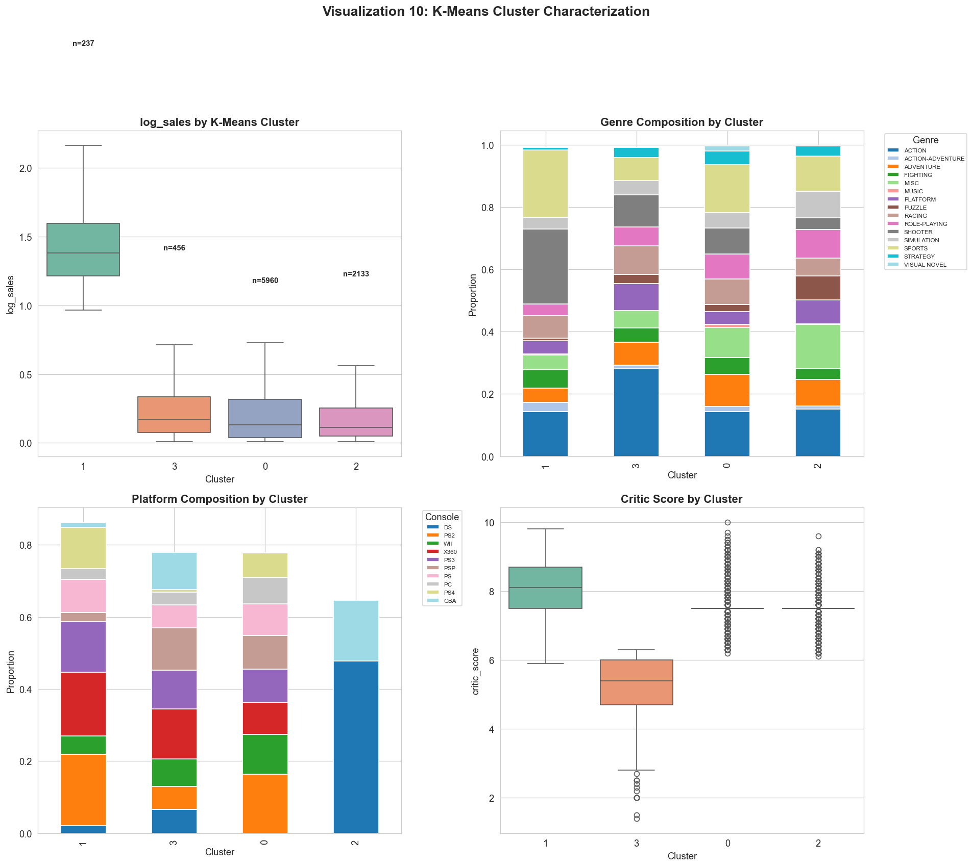
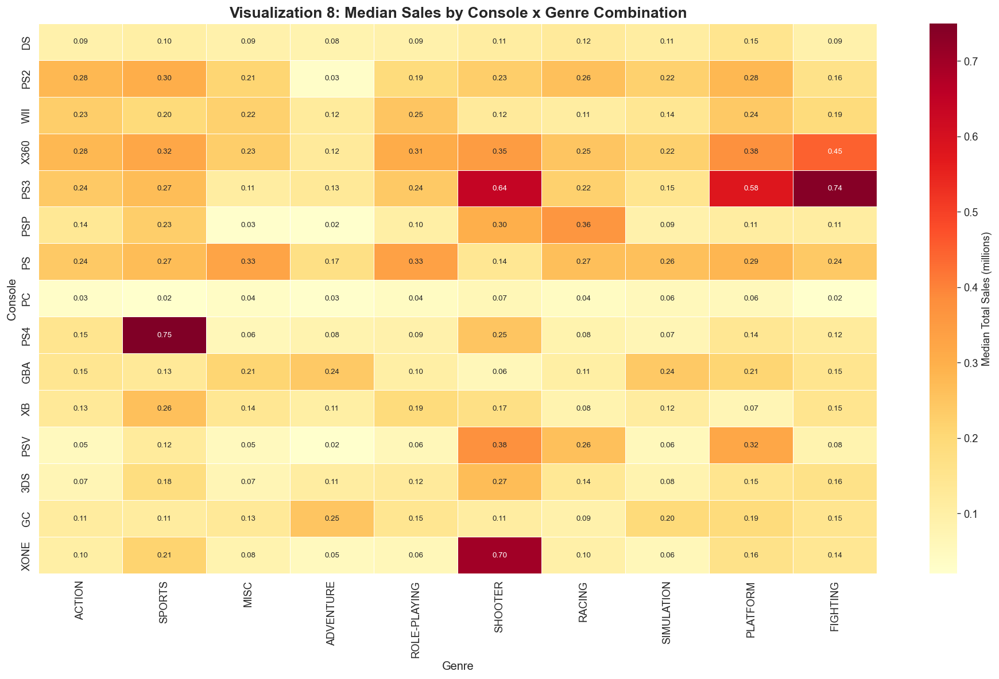
Three Core Market Laws
Brand dual mechanism: The brand influences sales through two paths - "scale" and "reputation", and they need to be modeled separately.
Sales hierarchy differentiation: K-Means identified only 2.7% of the best-selling levels, and the ratings were not the basis for the hierarchy.preferences.
Regional taste segregation: Players in the three major market regions (North America, Japan, Europe and Australia) have distinct preferences.
Platform × Genre Interaction: The combined effect is much greater than that of a single platform or a single type.

Slide 12
04
Model & Evaluation
From Exploratory Findings to Predictive Modelling
Dataset: cleaned_vgchartz.csv · 8,786 records · 80/20 stratified train-test split

Slide 13
Three Models: From Baseline to Blockbuster-Aware Hybrid
All models use log_sales as target to mitigate the extreme right skewness of raw sales data.
01
Multiple Linear Regression
02
Random Forest
03
Two-Stage Hybrid
Baseline · Interpretable
Test R² = 0.3123, RMSE = 0.2592
Interpretable coefficients for marginal effects
Statistical baseline for performance benchmark
Best Overall · Non-linear
• Test R² = 0.3937 (+26% lift vs baseline)
• Captures platform-genre interaction effects
• Robust to outliers; outputs feature importance
Segment Optimized
• Overall R² = 0.3775
• Blockbuster-segment RMSE
reduced by 6.7%
• Hybrid blend design for
sparse blockbuster data
Two-Stage Architecture
lockbuster RF
Specialized prediction
Game Attributes
Platform, Genre, Dev, Pub
Global RF
Base prediction
Blockbuster
Classifier
Flag high-sales games
Blockbuster RF
Specialized prediction
YES
Blended
Final prediction
Hybrid blend: classifier + dedicated regressor

Slide 14
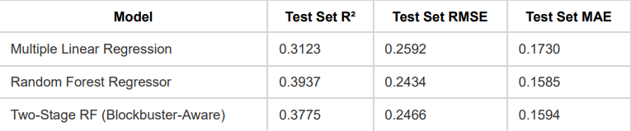
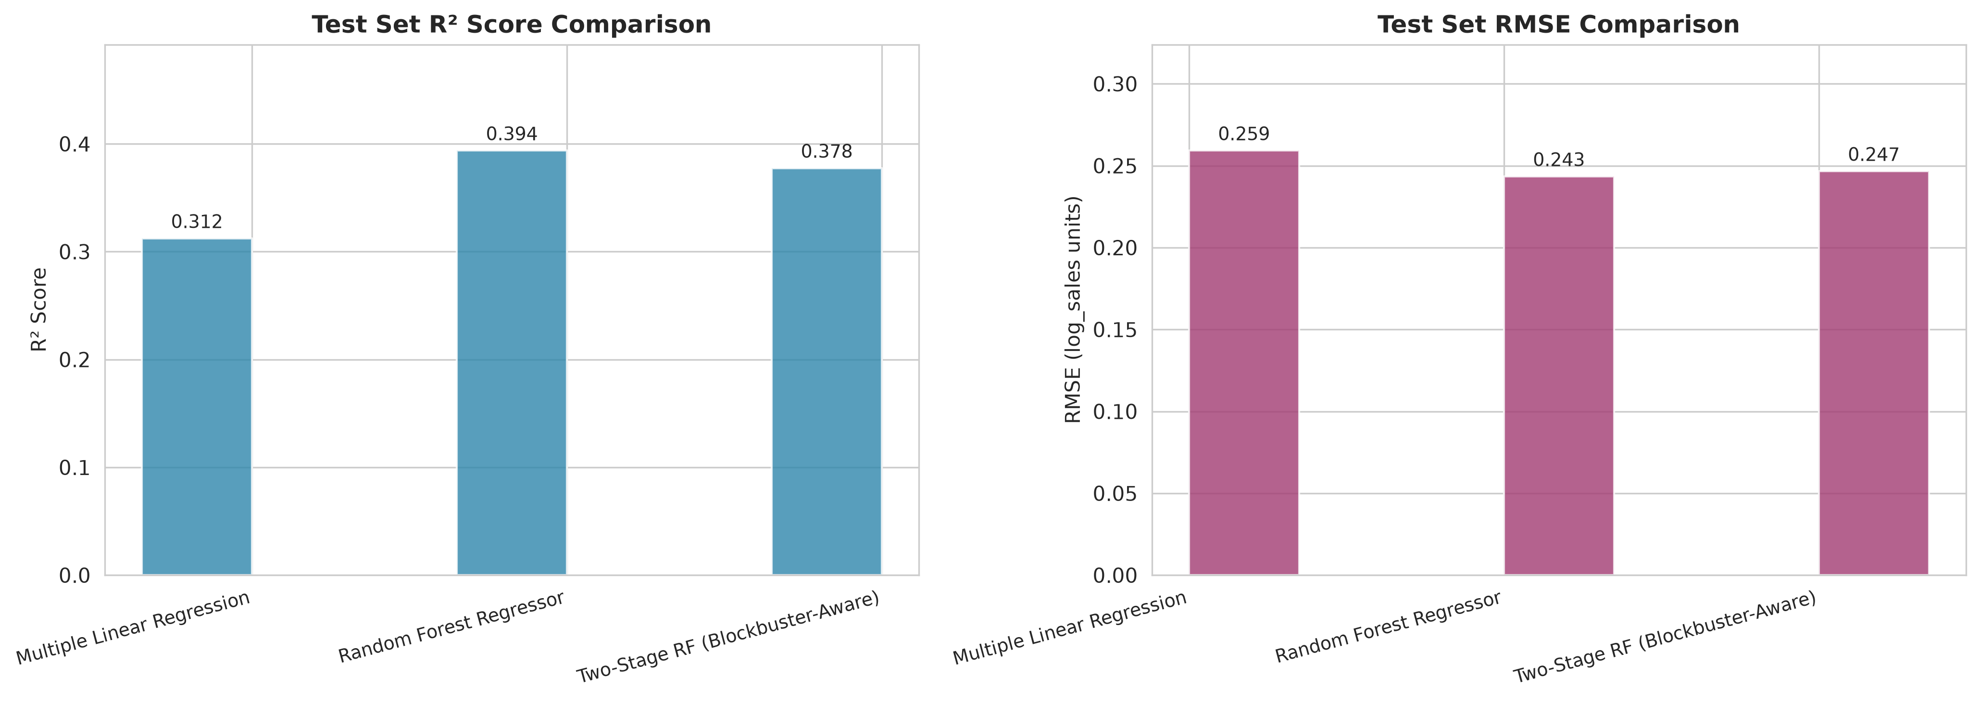
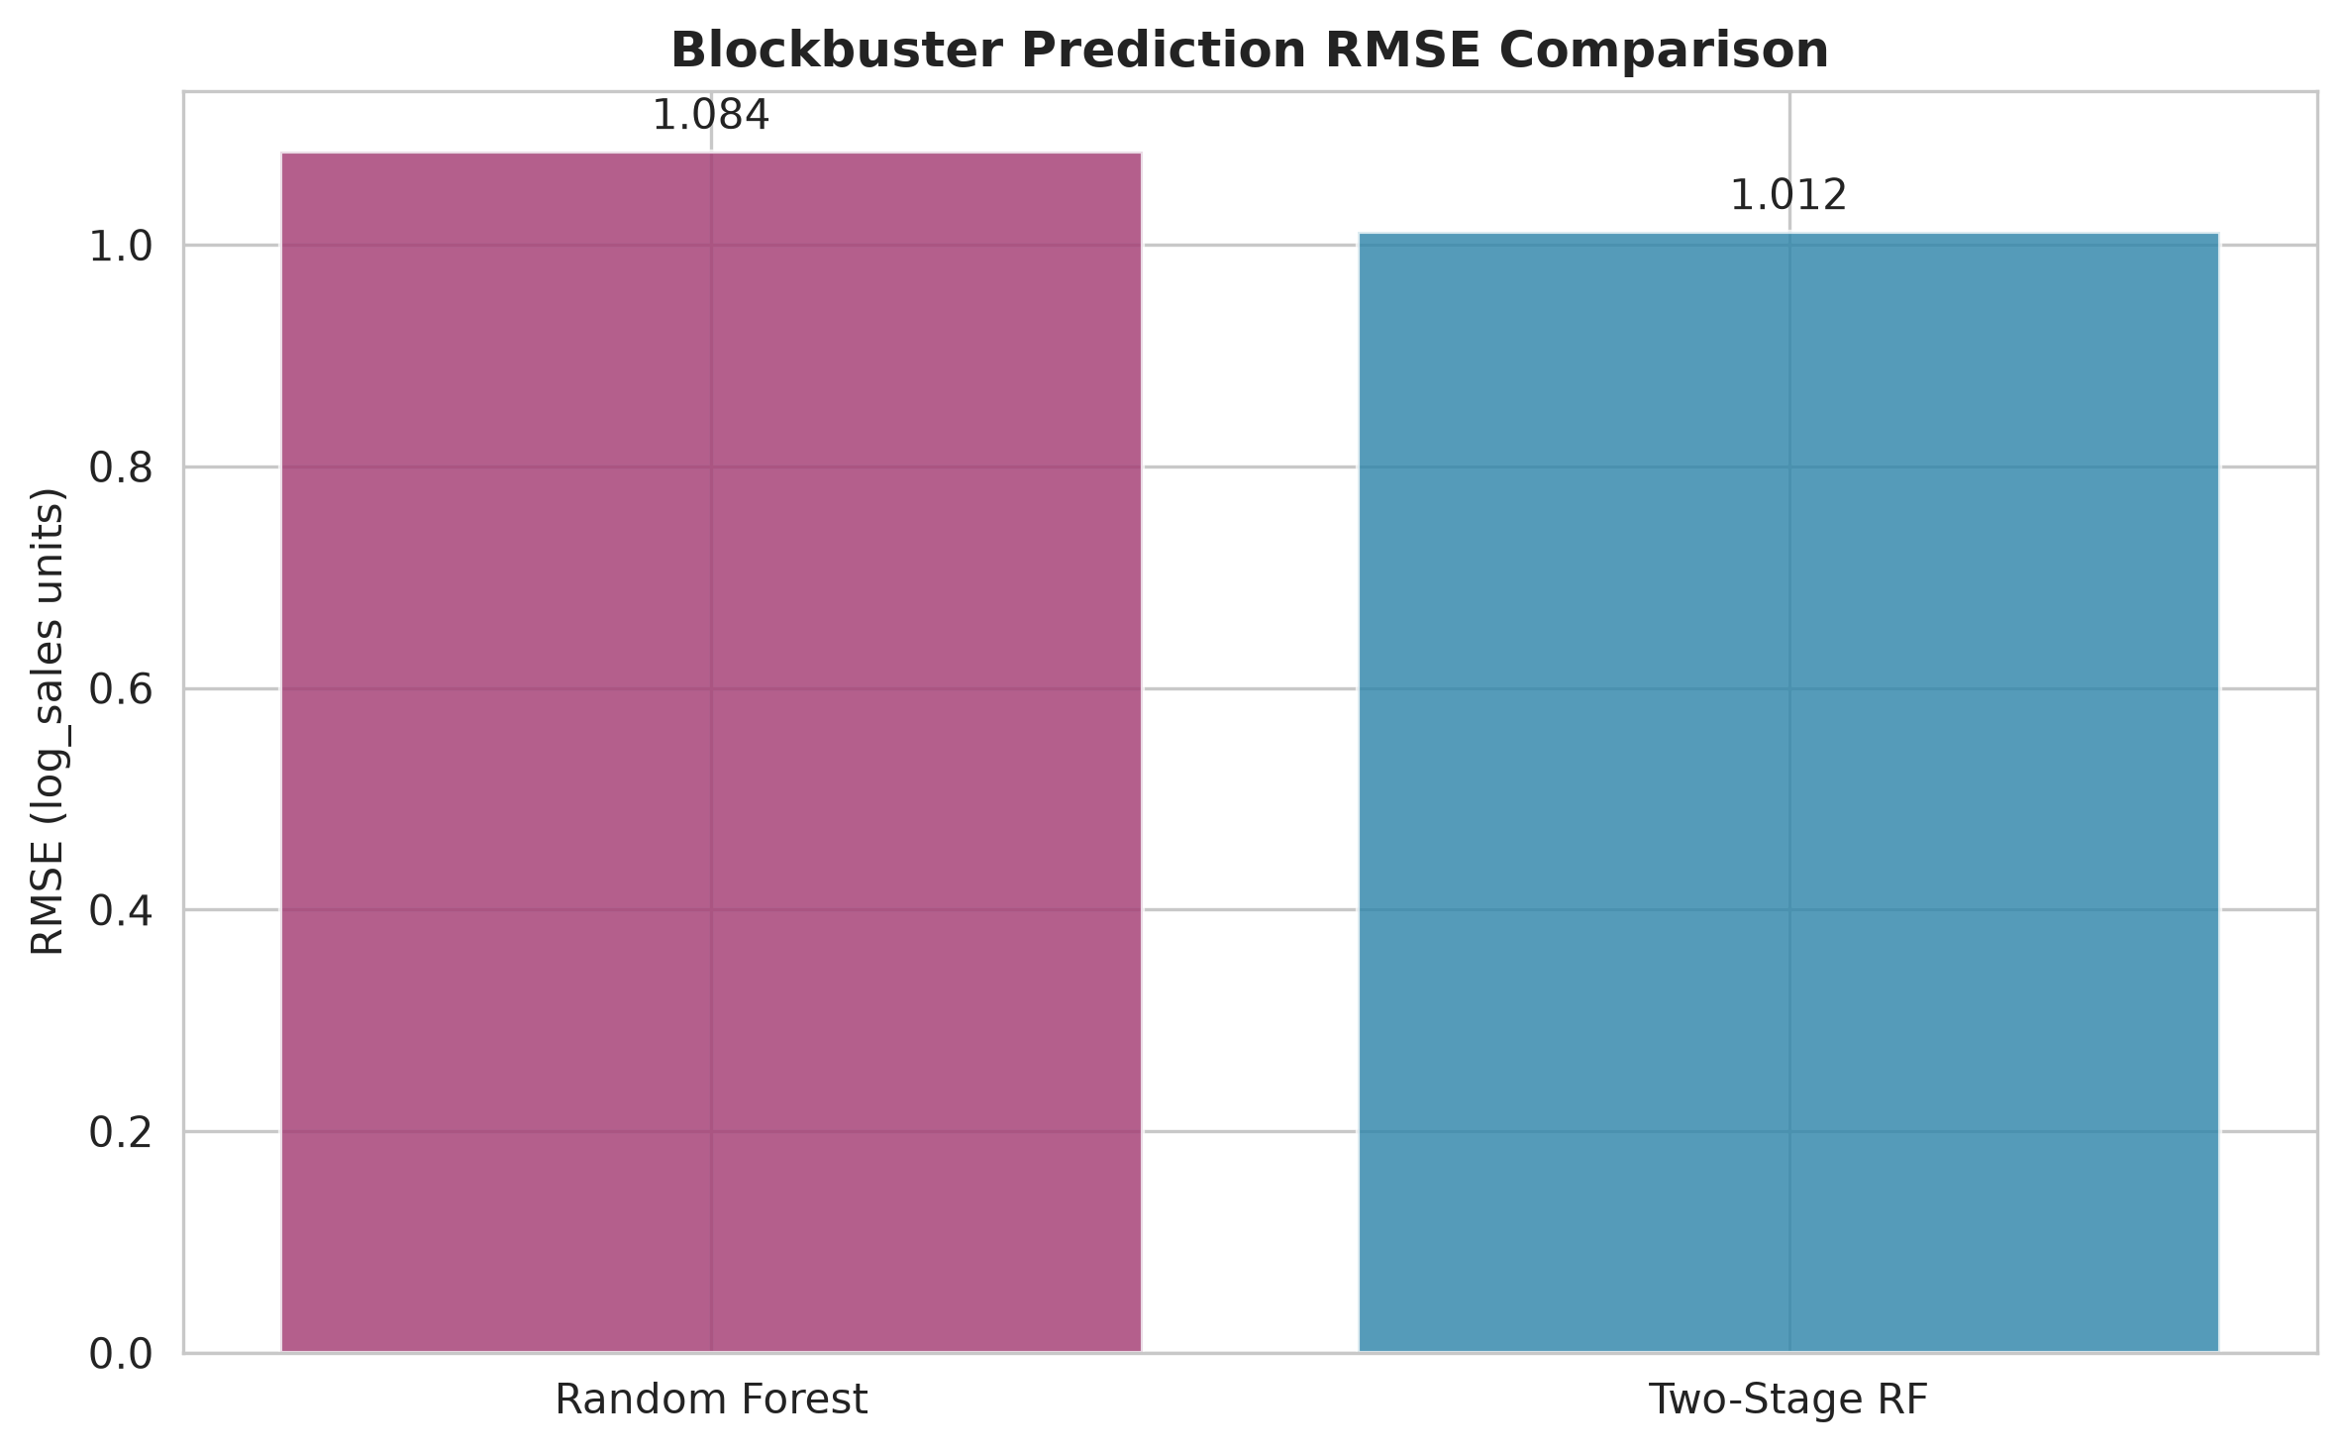
Performance on Holdout Test Set
Overall Performance Data Sheet
Model Performance Comparison Chart
Blockbuster Prediction RMSE Lift
Key Takeaways
Random Forest wins all overall metrics, confirming non-linear interactions
drive sales.
Two-stage model trades 1.6pp overall R² for 6.7% lower blockbuster RMSE.
No severe overfitting: 5-fold CV results align with holdout test performance.
General forecasting: Random Forest recommended; blockbuster focus:
two-stage model.

Slide 15
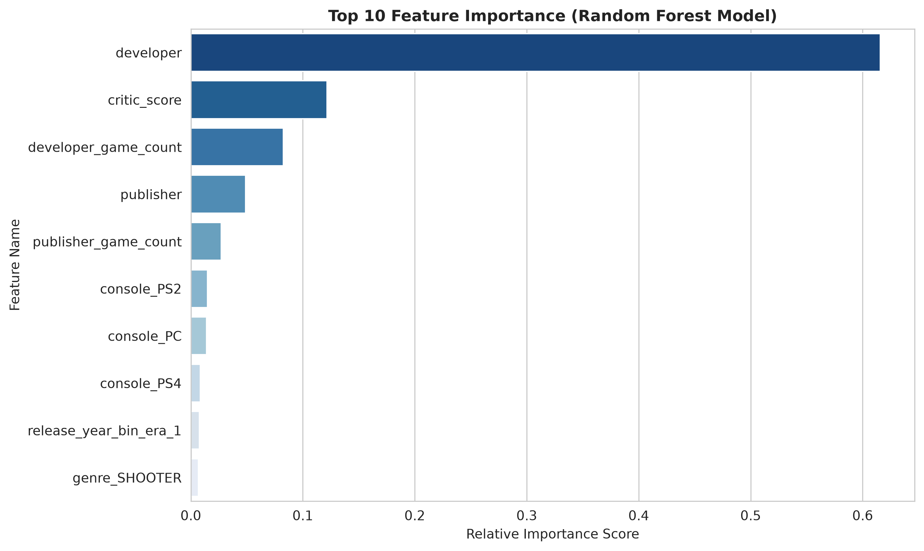
Key Sales Drivers & Research Question Verification
Top 10 Feature Importance Ranking
Top 3 Core Drivers
1.Publisher brand scale (publisher_game_count)
—distribution & channel resources
2.Game quality (critic_score)
— non-linear impact on market acceptance
3.Release era (release_year_bin) — market environment effects
Research Questions Verified
• Q1 Platform-Genre Synergy: Both features rank top 10;
26% R² lift confirms non-linear interaction effects.
•Q2 Genre-Regional Impact: Regional heterogeneity confirmed
by EDA; dedicated sub-models recommended
(global model excludes regional sales to prevent leakage).
•Q3 Brand Effect: Dual mechanism validated — scale is
dominant, while prestige delivers independent premium.
Note: This is the raw feature importance of all encoded features.
The aggregated business conclusion in the official report prioritises publisher scale as the top driver.

Slide 16
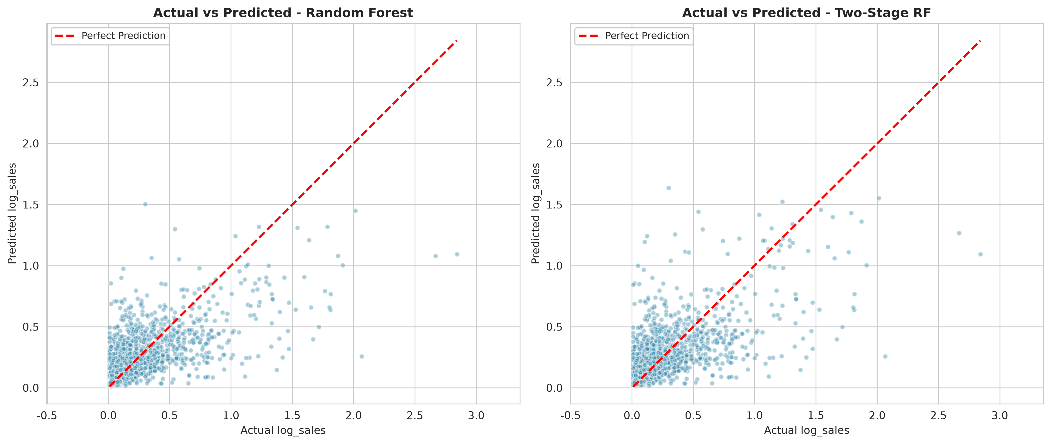
Prediction Reliability & Key Limitations
Actual vs Predicted Sales Scatter Plot
Reliability Conclusion
Reliable range: Mid-to-low budget mainstream games — predictions cluster closely to the perfect prediction line.
Systematic bias: Blockbuster titles are consistently underestimated, due to the long-tail sales distribution.
Improvement: Two-stage model pulls upper-tail predictions closer to actual values, reducing segment error by 6.7%.
Core limitations
Blockbuster sample scarcity: only 62 training records (0.9% of dataset) — data is the binding constraint
Digital sales undercount: bias for modern digital-first releases
Japan data gap: 63.7% zero-imputed records, limiting regional accuracy
Temporal risk: most data pre-2019; degrades for new platforms & monetization models
Source: M5 Modelling Report

Slide 17
05
Conclusion

Slide 18
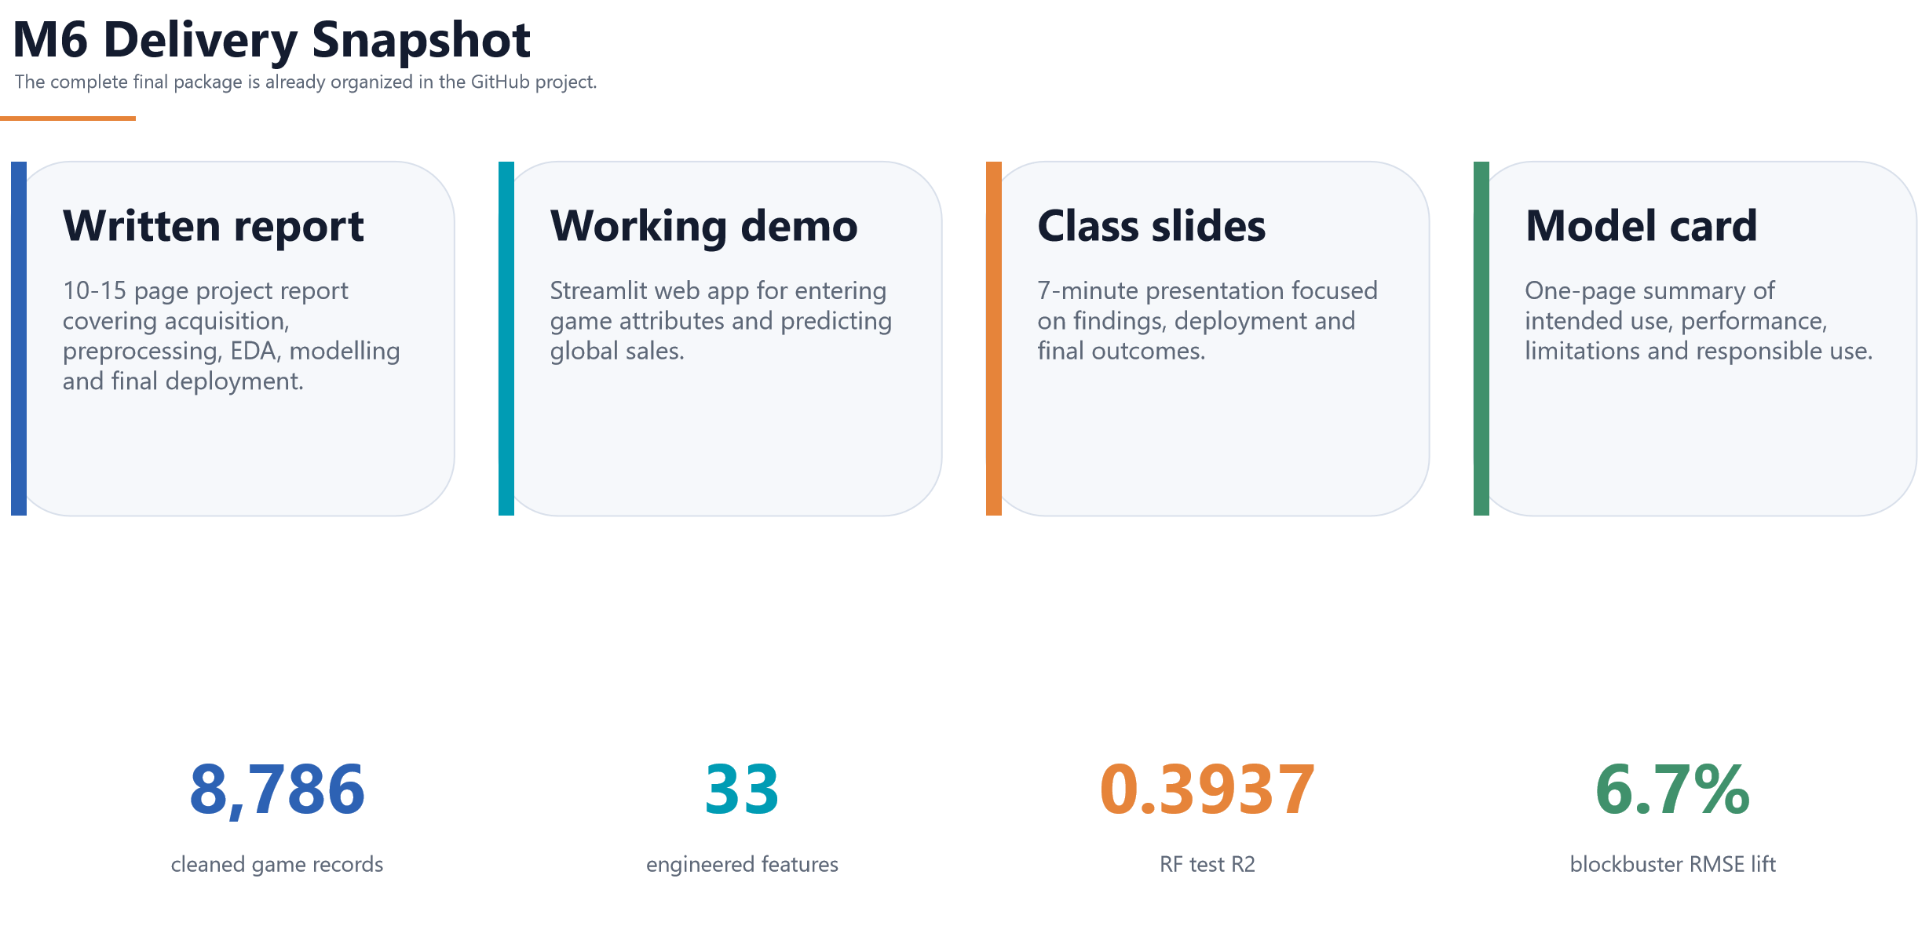

Slide 19
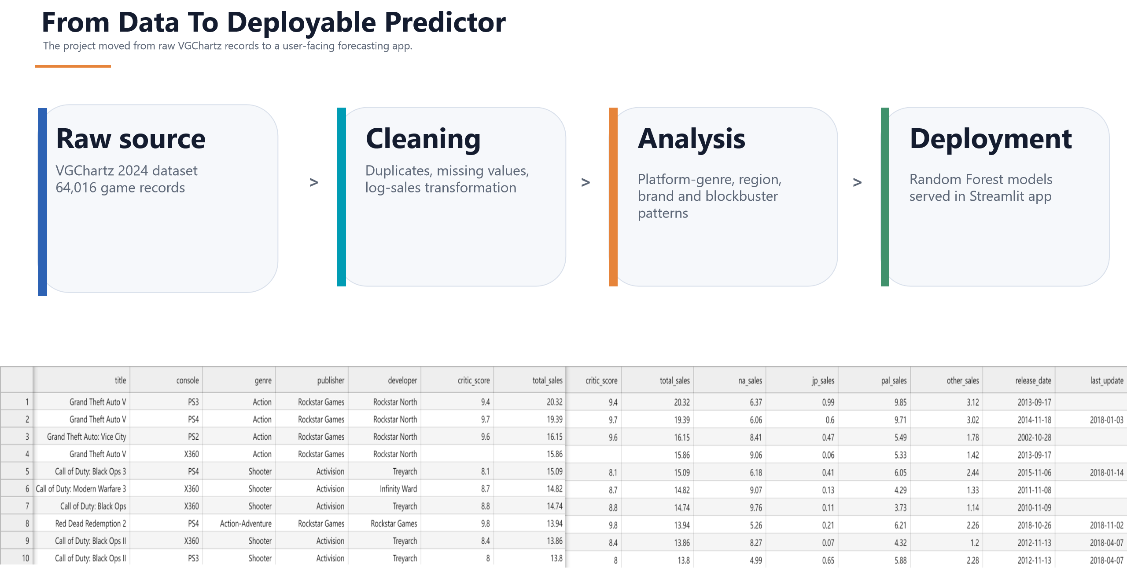

Slide 20
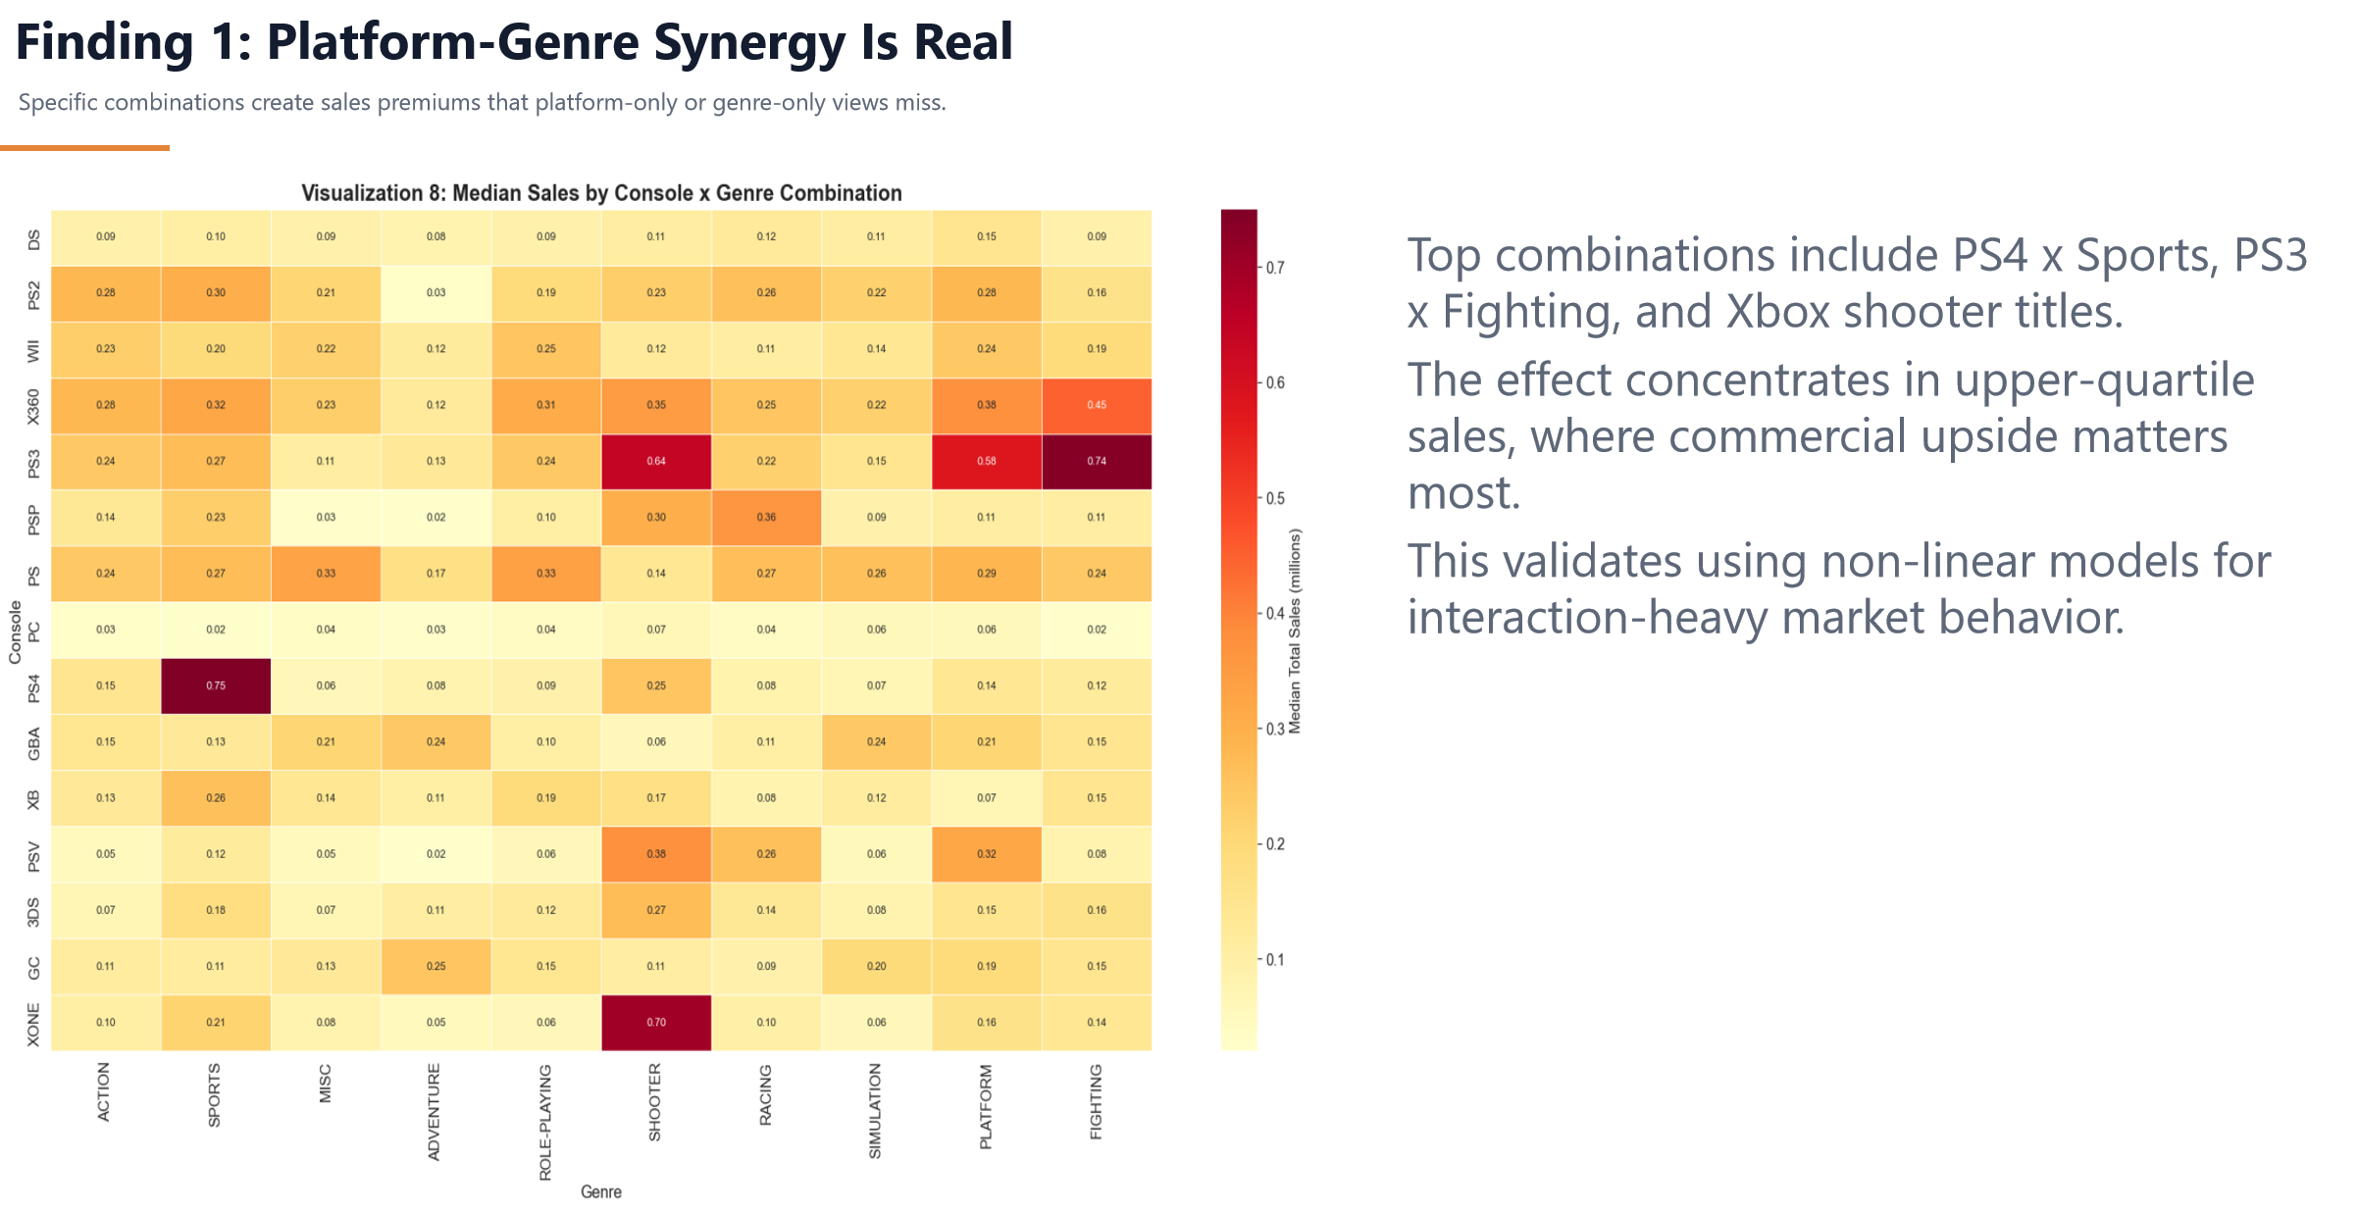

Slide 21
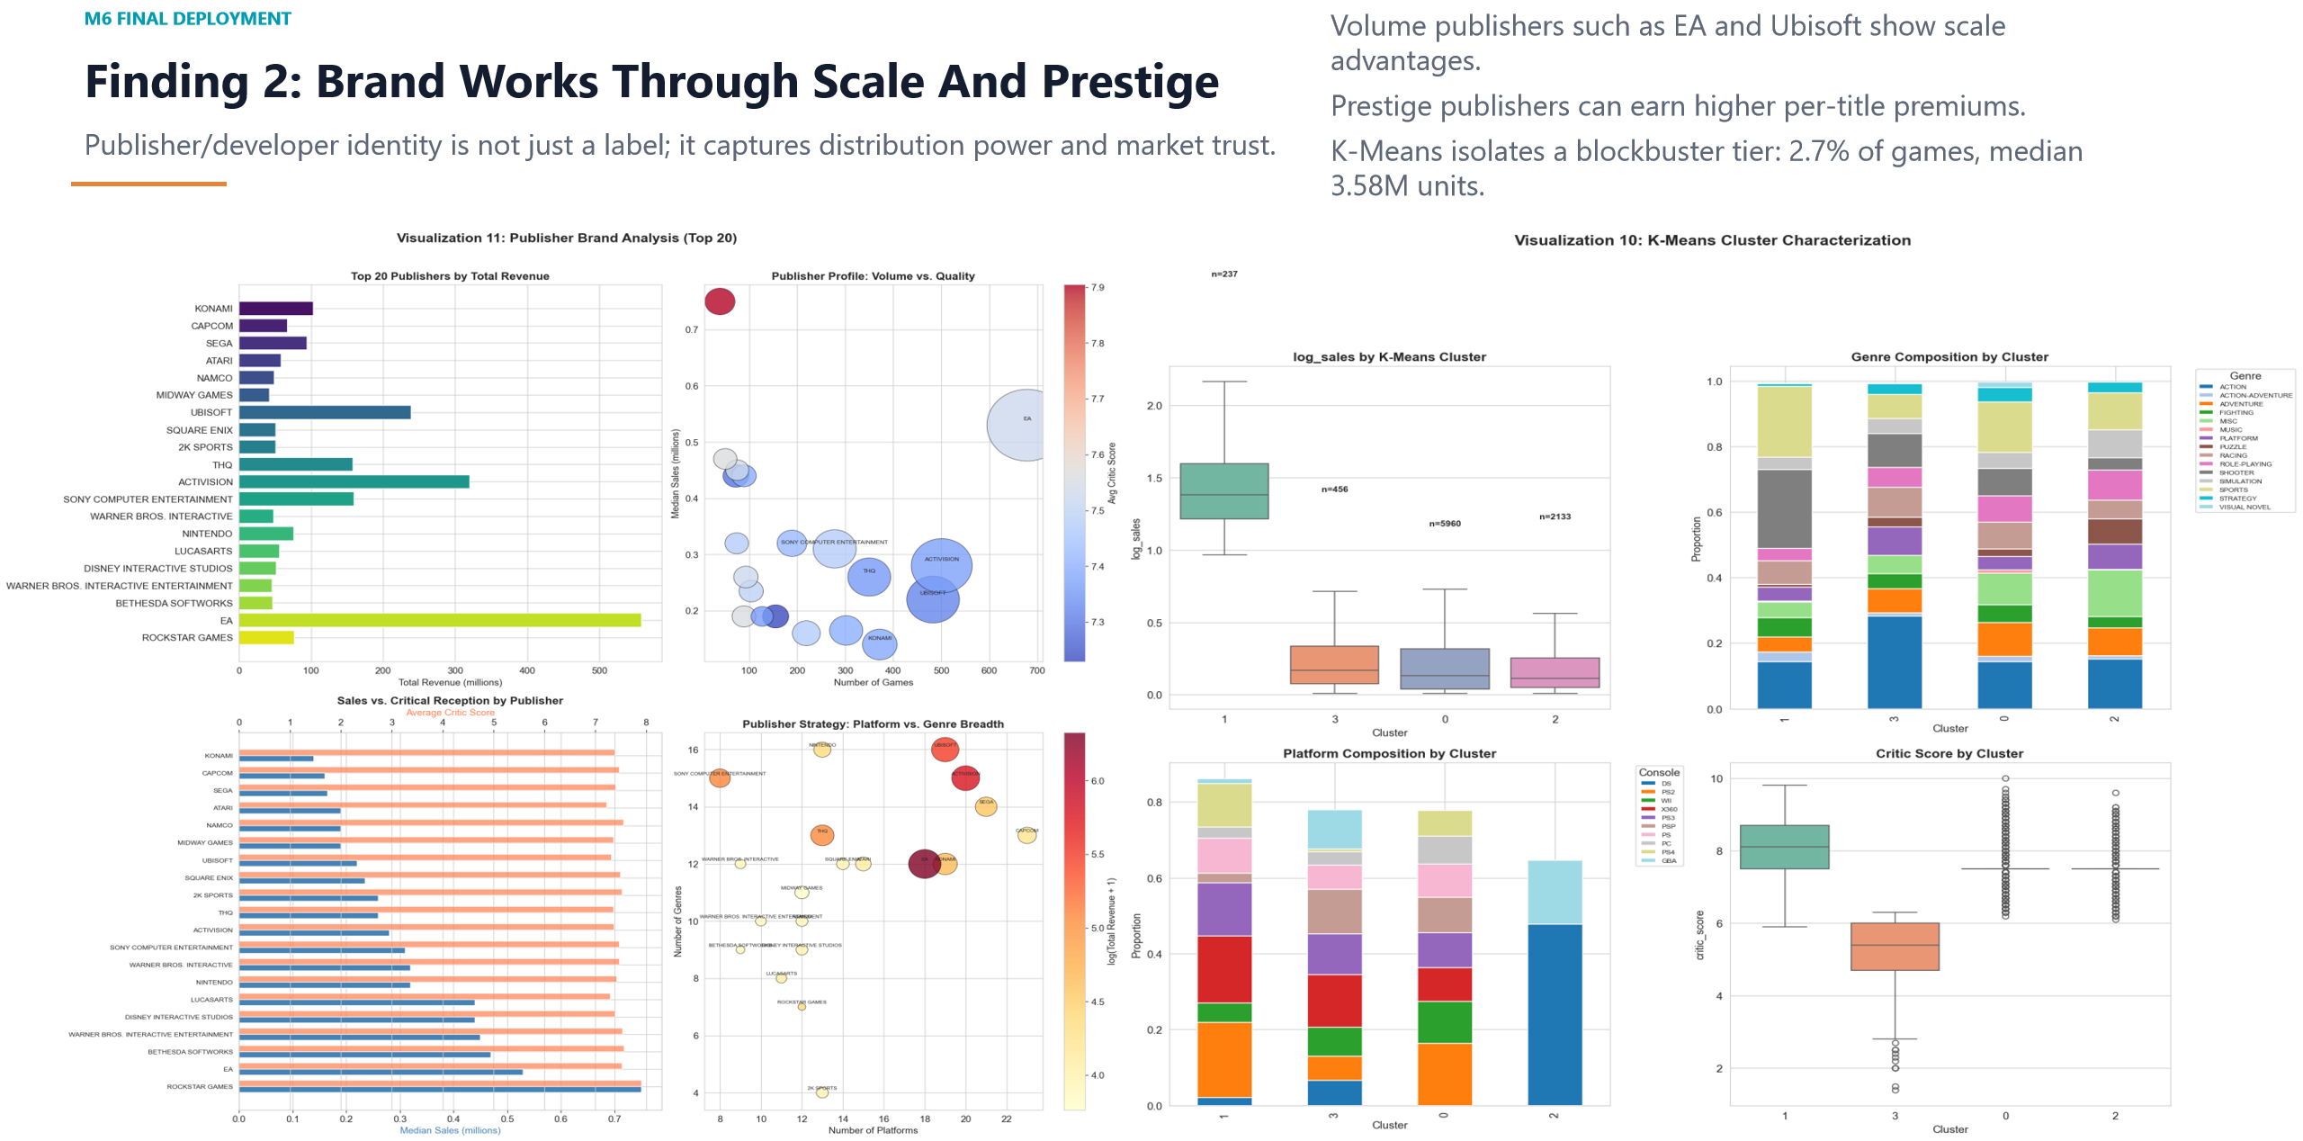

Slide 22
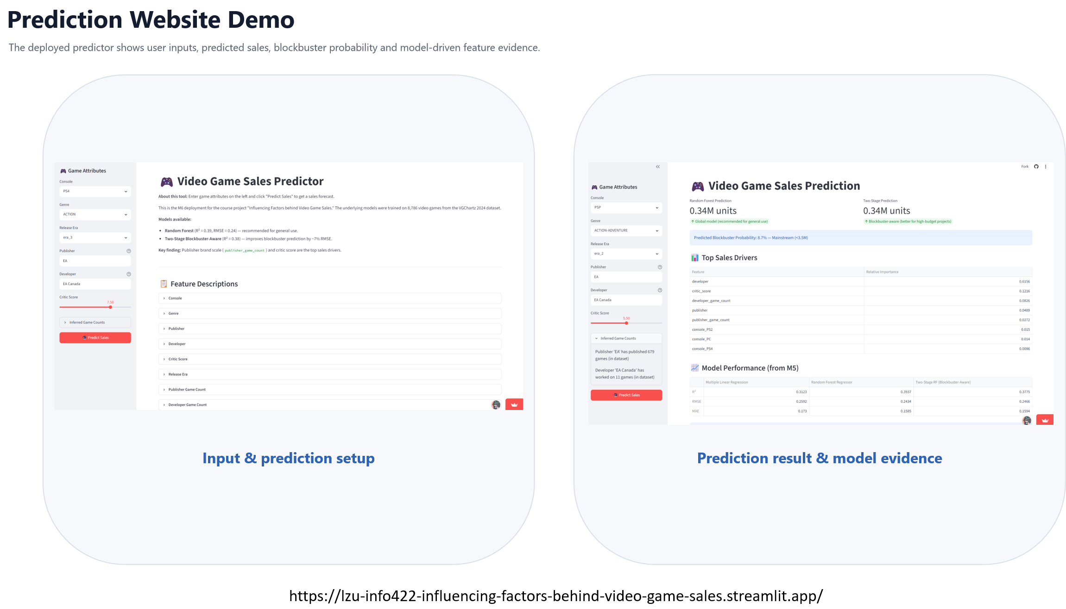
Limitations & Next Steps
# Limitations
1. Only predicts global sales, no regional breakdown
2. Japan data heavily imputed; blockbuster samples rare
# Next Steps
1. Build separate regional sales prediction sub-models
2. Optimize regional imputation for Japan data
3. Add regional market preference features
4. Supplement modern digital & new console data
https://lzu-info422-influencing-factors-behind-video-game-sales.streamlit.app/

Slide 23

THANK YOU FOR WATCHING！
Group 23
Report date: 2026/7/1

